Slide 1

STAYING ALIVE

Slide 2
Physical Challenge
Lack of exercise
Bad diet
Too much sitting
Unhealthy life style
RUNNING

Slide 3
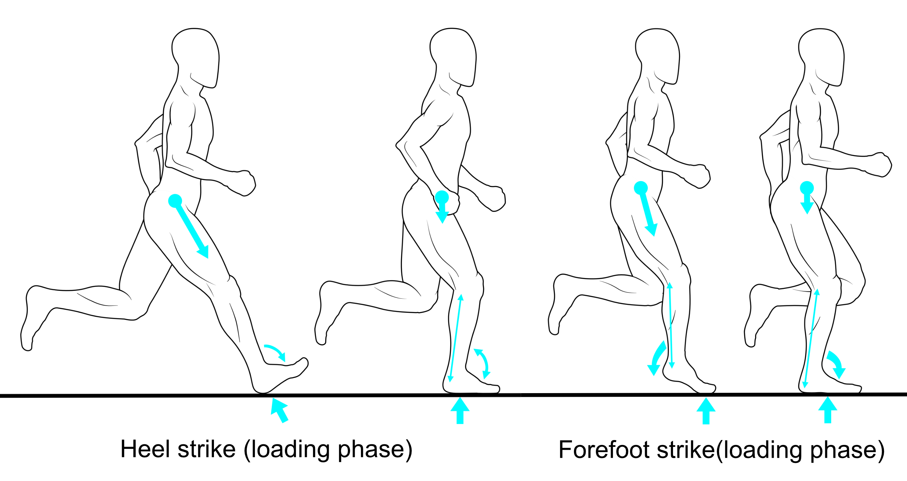
How do you run properly though?

Slide 4
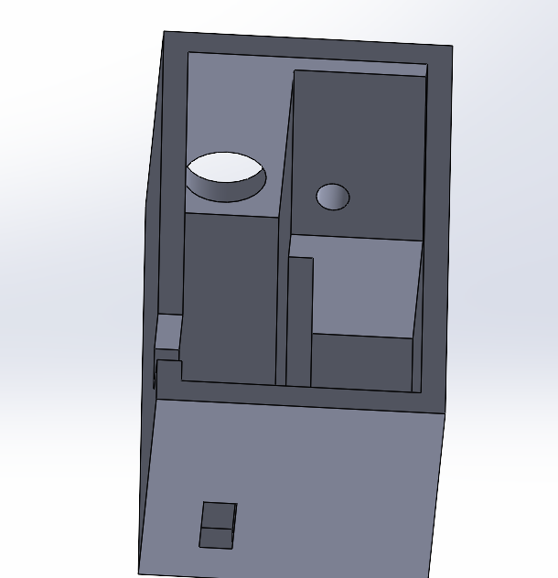
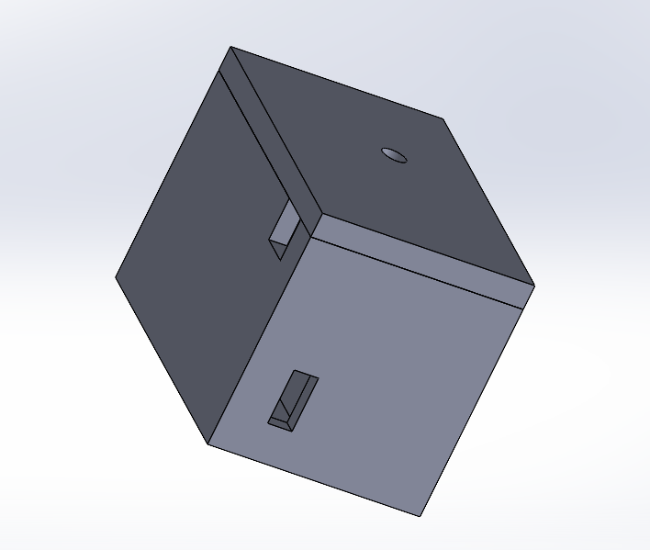
Our Design

Slide 5
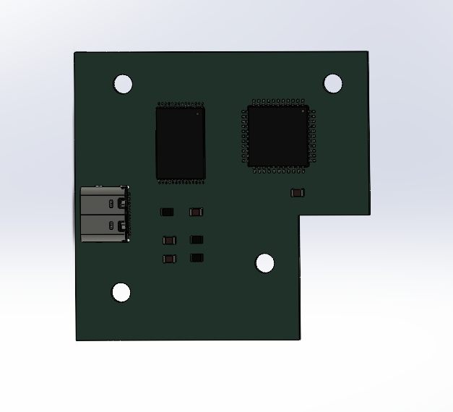
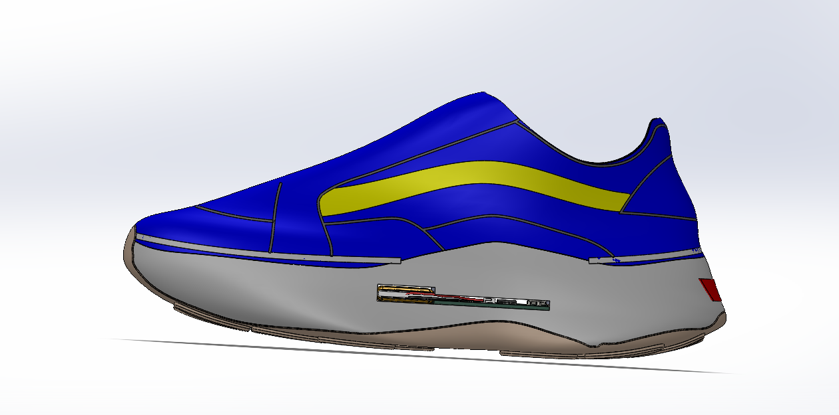
concept

Slide 6
